Slide 1


IRUNGATTUKOTTAI,SRIPERUMBUDUR,CHENNAI-602117.
(AFFLIATED TO ANNA UNIVERSITY AND APPROVED BY AICTE, ACCREDITED NAAC AND NBA)
IoT BASED COLLEGE ATTENDANCE AND TRANSPORTATION MONITORING SYSTEM
TEAM MEMBERS
1. Magesh. G - 210819106034
2. Naveenkumar.V – 210819106046
UG Scholar
Department Of ECE
SUPERVISOR
Dr .C. John Clement Singh.
Professor / ECE

Slide 2
OUTLINE
Abstract
Objective
Introduction
Problem Statement
Proposed System
Existing system
Literature Survey
Hardware and Software
Methodology
Work Modules
Project Setup
Result
Conclusion
Future Scope
Reference
Appendix

Slide 3
ABSTRACT
This paper presents an IoT Based College Attendance and Transportation Monitoring System using Arduino Uno R3 (ATmega328p), NodeMCU (ESP-8266) is used to monitor the attendance of students and staff in a college. The system also tracks the movement of college buses and provides real-time information to the parents.
The Attendance of students and staff is recorded by the Fingerprint sensor (Biometric Authentication), while the movement and speed of college buses is tracked by the GPS Module. The Web Camera is used for monitor the students, staffs and driver. The Force sensor will detect the crash of the bus and send alert message to the institution, Parents, including institution website. The data collected by the system is stored in a Cloud Database and can be accessed by the college authorities as well as the parents. The system is cost-effective and efficient in Monitoring the Attendance and Transportation of students and staff at the college.
KEYWORDS: IoT, Attendance, Transportation, Monitoring system, Real time Location, Biometric Authentication.

Slide 4
OBJECTIVE
The objective of the IoT-based College Attendance and Transportation Monitoring System using Arduino, NodeMCU, GPS Module, Fingerprint Sensor, Buzzer, Force Sensor, WEB Camera and Cloud Database is to provide a secure, reliable, and automated system to monitor student's attendance and transportation.
The system will be able to accurately detect the attendance and transportation of students, while also providing real-time Location to parents and the institute.
Additionally, it will enable the institute to track student's whereabouts, monitor the safety of students, and control the use of transportation services.
The aim of this project is providing safety for the student throughout transportation to from the college. Parents can monitor the location of the bus, pickup timing and drop timing with Real time location. The speed of the bus is monitored and updated to college and if any accident occurred both parents and college are shared with the bus’s location.

Slide 5
INTRODUCTION
The Internet of Things (IoT) based College Attendance and Transportation Monitoring System is an innovative solution to improve the efficiency of college attendance and transportation management.
This system uses IoT technology to track the attendance and transportation of students in real-time. It helps college administrators to monitor the attendance of students and the transportation of students to and from the college.
The system also helps to improve the safety of students by providing real-time alerts and notifications in case of any emergency.
The system also provides analytics and reports to the college administrators to help them make informed decisions.
This system can be used to improve the efficiency of college attendance and transportation management and ensure the safety of students.

Slide 6
PROBLEM STATEMENT
The problem statement for IoT-based college attendance and transportation monitoring system was Currently, many colleges rely on manual record-keeping methods for attendance tracking and do not have real-time information about the location of college buses. This can lead to inaccuracies in attendance tracking and make it difficult to respond quickly to any transportation issues that may arise.
Moreover, traditional attendance systems can be easily manipulated by students, leading to incorrect attendance records. These problems can be compounded by challenges such as traffic congestion and delays, which can further complicate the transportation process and put the safety of students at risk.
Therefore, there is a need for an IoT-based college attendance and transportation monitoring system that can accurately track the location of college buses in real-time and monitor student attendance automatically, thus ensuring the safety and security of college students and simplifying the attendance tracking process.

Slide 7
PROPOSED SYSTEM
This project helps both parents and college administration to manage and monitor numerous factors like number of students , location etc.
Along with the student’s fingerprint data the geographical coordinates of the bus are fetched by the GPS Module and then uploaded to an server using Node MCU (WIFI Module).
Speed of the bus is monitored and if the bus exceeds the normal speed then the speed of the bus is updated to college administration with its GPS location.
If the bus faces any accident the location is updated to both parents and college administration.
EXISTING SYSTEM
The existing system involves manual work to manage the college transportation which may lead to human error.
Only driver can monitor the speed of the bus.
Lack of security to the students.

Slide 8
LITERATURE SURVEY
Literature Survey for IoT Based College Attendance and Transportation Monitoring System
Table:1
S.NO | TITLE | JOURNAL | AUTHOR | OBJECTIVE | RESULT | ISSUES
1. | Attendance Monitoring in Classroom Using Smartphone & Wi-Fi Fingerprinting | IEEE | Anand; Kamal Bijlani; Sheeja Suresh 16-01-2017 | The facial recognition via the smartphone's front camera to determine the student's identity, the system also makes use of the campus Wi-Fi network to determine the student’s location. | This system show that fingerprinting, which is the technique used here to determine indoor location, can achieve very good positioning accuracy even in classroom environments, where signal interference is usually very high. | Students pick up and drop time is not updated. Accident are Not detected.
2. | An Intelligent and Secured Tracking System for Monitoring School Bus | IEEE | Asif Ahmed; M M Rayhan Parvez; Md Hridoy Hasan; 02-09-2019 | All buses can be tracked by the guardians using the proposed intelligent and secured tracking system for school buses. | A smart school bus will keep the student safe, easing the tension for parents and the city will have a smooth traffic system. | Students pick up and drop time is not updated. Accident are Not detected.
3. | IoT Based Intelligent Real-Time System for Bus Tracking and Monitoring | IEEE | Mona Kumari Ajitesh Kumar; Arbaz Khan; 07-05-2020 | Smart education is the use of computers in the classroom. One part is the amount of time the child spends on a bus from traveling bus to home. Although, with currently available technologies as the Internet of Things (IOT) and Android, with these advanced technologies we will be able to track or visibility in a child's life. | This system permits parents, schools and regulatory bodies to track the conditions of comfort and safety inside a bus in a real-time manner. A variety of reports for various activities for bus comfort and attendance are then generated from this real-time providing complete visibility of buses. | Accident are not detected. Students bus pickup and drop time are not updated

Slide 9
Table:2
S.NO | TITLE | JOURNAL | AUTHOR | OBJECTIVE | RESULT | ISSUES
4. | IoT Based Smart Attendance Monitoring System | IEEE | Unnati Koppikar and Hiremath; 10-02- 2020 | The students just need to place their RFID card or tag on the reader and their attendance will be recorded for the day. Also, the attendance recorded will be more accurate as the system is synced with a real-time clock. | RFID reader located inside the system detects the RFID tags of students and sends attendance to the institution | Can’t able to monitor the real-time information for transportation and Accident will not detected. Students bus pickup and drop time are not updated
5. | The Design of Cold Chain Transportation Monitoring System Based on NB-IoT | IEEE | B. Bharathi and N. Nivedhitha. 21-09-2021 | Cold chain transportation is an important link to ensure product quality. If the lack of real-time monitoring and effective management of the cold chain transportation process will lead to economic losses and safety accidents. | can effectively solve the cold chain transportation monitoring management work in practical applications Existing problems. | Attendance will doesn’t monitored and Accident will not detected. Students bus pickup and drop time are not updated
6. | Cloud Based Smart Attendance System for Educational Institutions | IEEE | Vikas Yadav and G. P. Bhole 11-10-2019 | Based on the IoT paradigm, a prototype of a cloud-based end-to-end Smart Attendance System has been developed which attempts to solve the problems of manual attendance system prevalent in school and colleges by performing automated attendance of the educational institute. | To reduce the overall time required to take the attendance in the class the attendance device is made portable, so that it can be easily circulated among students to mark their attendance. The system has been tested and results are encouraging to catapult further study and research in this area. | Accident are not detected. Students bus pickup and drop time are not updated

Slide 10
HARDWARE REQUIREMENTS
Arduino Uno (ATmega328P).
NodeMCU (ESP8266).
Fingerprint Sensor (R307).
GPS Module (NEO – 6M).
Force Sensor (FSR 402).
WEB Camera.
Jumper wires.
9V Power Supply.
SOFTWARE REQUIREMENTS
Embedded C
HTML
CSS
PHP
My SQL

Slide 11
METHODOLOGY
Arduino UNO is used as the controller. Arduino receives fingerprint data as Input from a fingerprint sensor. Sensor data are used in updating students In and Out time with location.
GPS module is used to fetch the location coordinates of the student and to monitor the speed of the bus.
Force sensor output are continuously monitored by the controller if the output is abnormal then the controller updates college administration with the location coordinates
Wi-fi module is used in updating process. Location and sensor data’s are uploaded to Cloud. College Administration and parents can access the data uploaded to the cloud.

Slide 12
Block Diagram for IoT Based College Attendance and Transportation Monitoring System
Power Supply
Force Sensor
WEB Camera
College
GPS Module
Cloud
NodeMCU
Fingerprint Sensor
Arduino UNO
Buzzer
Parents
FigNo:1 Block Diagram

Slide 13
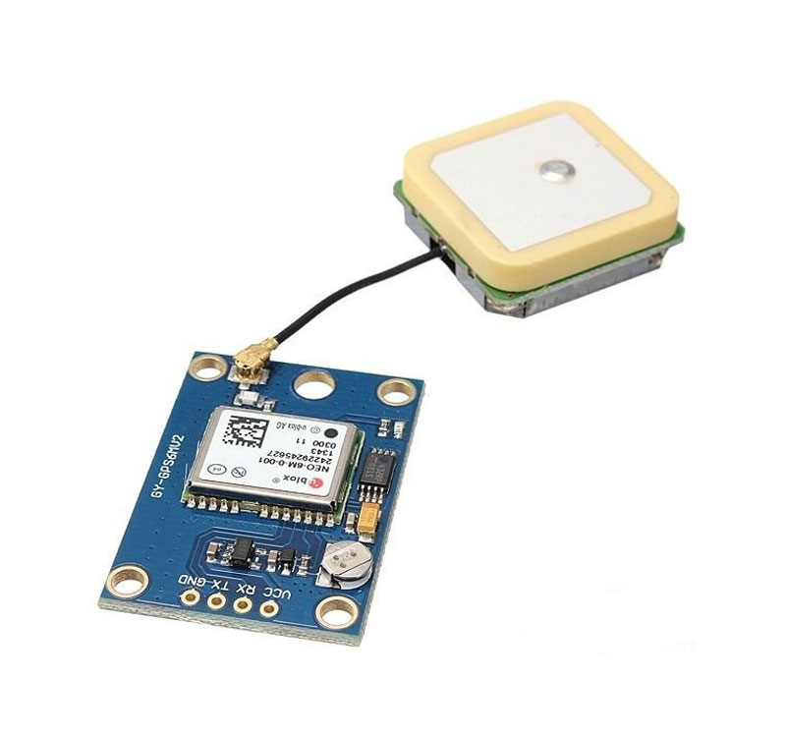
WORK MODULES FOR IoT BASED COLLEGE ATTENDANCE AND TRANPORTATION MONITORING SYSTEM
GPS-NEO-6M GPS module that can track up to 22 satellites and identifies locations anywhere in the world.
It may serve as a great launch pad for anyone looking to get into the world of GPS.
At the heart of the module is a NEO-6M GPS chip from u – blox.
The chip measures less than the size of a postage stamp but packs a surprising amount of features into its little frame.
It can track up to 22 satellites on 50 channels and achieves the industry’s highest level of sensitivity i.e -161dB tracking while consuming only 45mA supply current.
FigNo:2 GPS MODULE

Slide 14
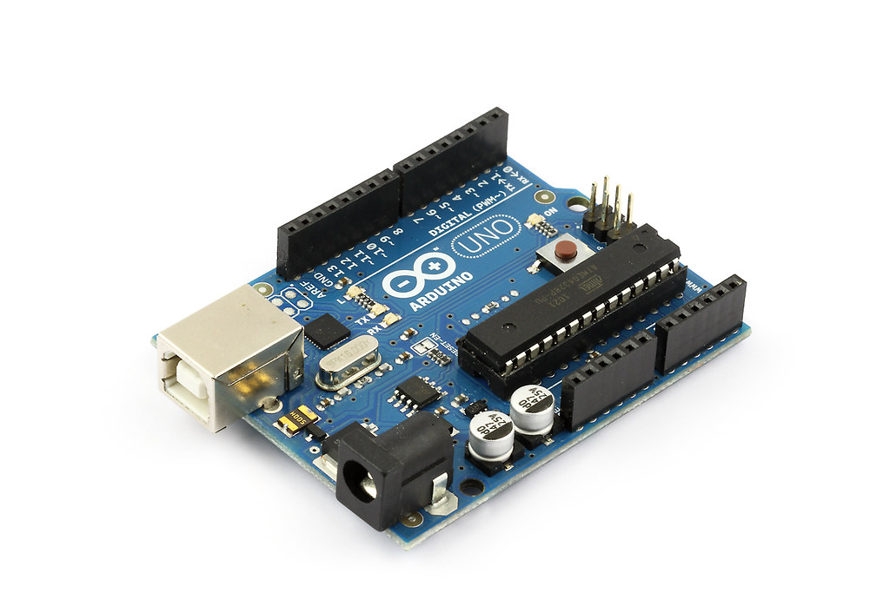
The Arduino UNO is a microcontroller board based on the ATmega328p.
It has 14 digital input/output pins (of which 6 can be used as PWM outputs), 6 Analog inputs, a 16 MHz crystal, Oscillator, a USB connection, a power jack, as ICSP header and a reset button.
It contains everything needed to support the microcontroller; simply connect it to a computer with a USB cable or power it, with a AC to DC adapter or battery to get started.
The UNO differs from all preceding boards in that it does not use the FIDI USB-to-serial driver chip.
FigNo:3 Arduino UNO

Slide 15
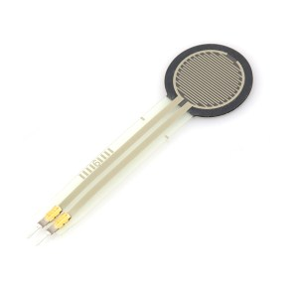
The Force sensor is also known as force sensing resistor, force sensitive resistor, or just FSR.
The Force sensor is basically a resistor that changes its resistive value depending on how much it has been pressed.
Good and detecting physical pressure, squeeze.
The Force sensor is used in electronic drums, mobile phones, handheld gaming devices and many more portable electronics.
FigNo:4 Force Sensor

Slide 16
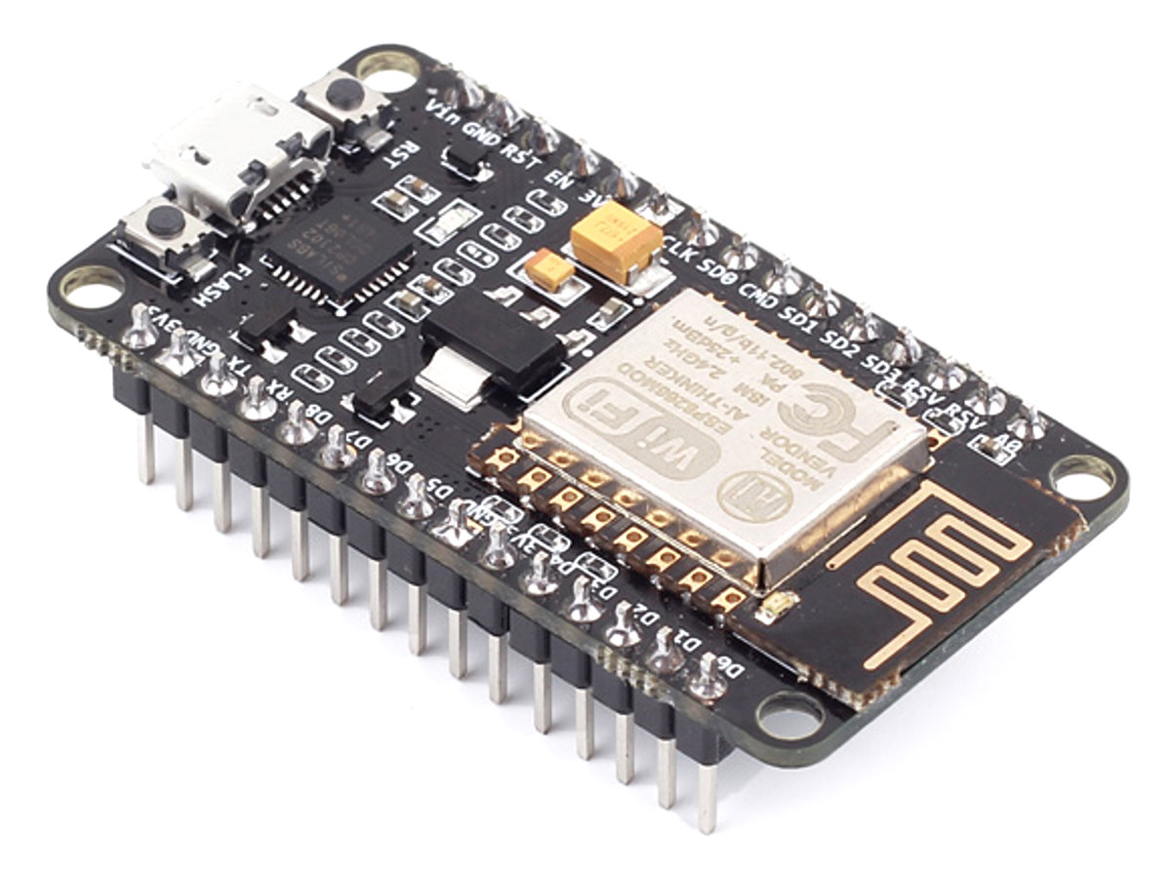
NodeMCU is an open source Lua based firmware and development board specially targeted for IoT based applications.
The NodeMCU ESP8266 development board comes with the ESP-12E module containing the ESP8266 chip having Tensilica Xtensa 32bit LX106 microprocessor.
NodeMCU has 128KB RAM and 4MB of flash memory to store and data programs.
NodeMCU can be powered using a micro USB jack and Vin pin. It supports UART, SPI and 12C interface.
FigNo:5 NodeMCU

Slide 17
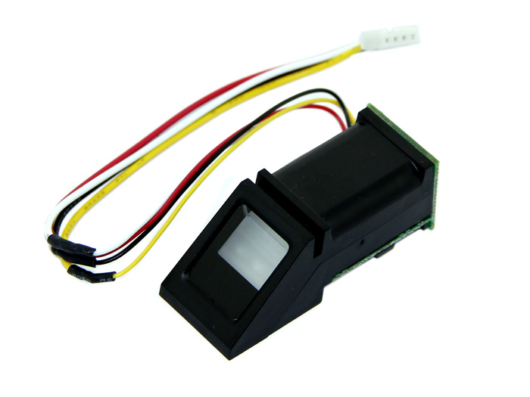
R307 fingerprint module consists of optical fingerprint sensor, high speed DSP processor and other hardware and software composition, stable performance, simple structure with fingerprint entry, image processing.
The R307 fingerprint module has two interface TTL UART and USB 2.0.
USB 2.0 interface can be connected to the computer; RS232 interface is a TTL level, the default baud rate is 57600.
Needs to connect the computer level conversion, level conversion note, embodiments such as a MAX232 circuit.
FigNo:6 Fingerprint Module

Slide 18
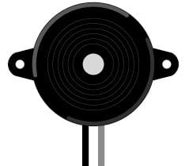
It is a simple device which can generate beeps and tones.
Working principle of the device is a piezoelectric effect.
The main component of this device is a piezo electric crystal, a special material that change shape when a voltage applied to it.
Simply change the frequency of the voltage sent to the piezo and it will start generating sounds by changing shape very quickly.
FigNo:7 Buzzer

Slide 19
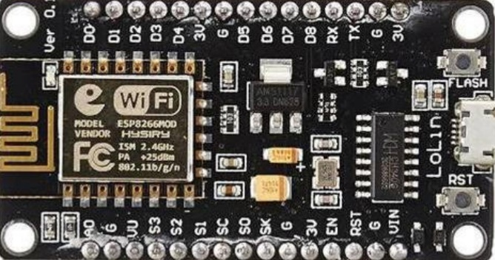
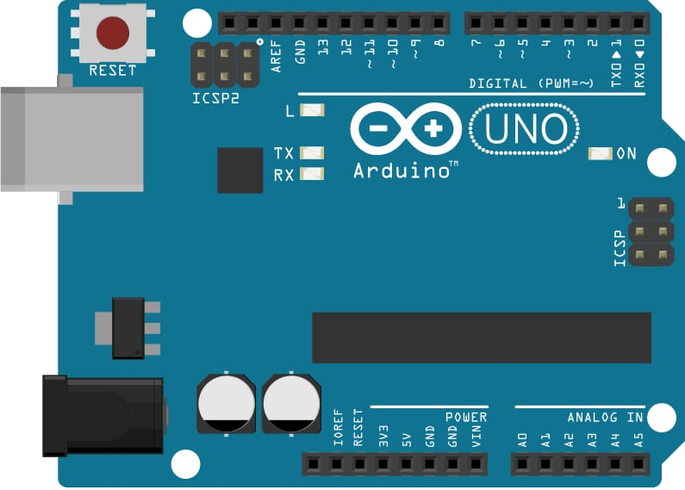
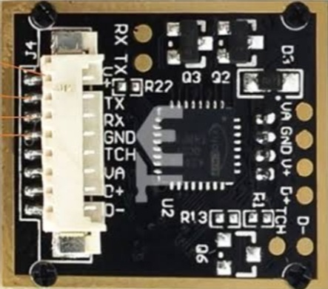
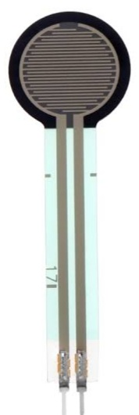
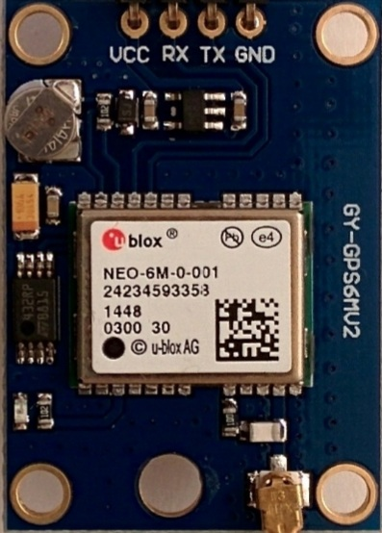
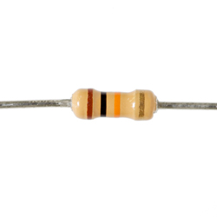
CIRCUIT DIAGRAM IoT BASED COLLEGE ATTENDANCE AND TRANPORTATION MONITORING SYSTEM
ARDUINO UNO
D6
D5
D1
D2
BUZZER
NODE MCU
Gnd
A0
5V
9
Gnd
Vin
Vin
Tx
Rx
FINGERPRINT SENSOR
Gnd
Tx
Rx
Vin
Gnd
FORCE SENSOR
GPS
10k
Vin
Gnd
FigNo:8 Circuit Diagram

Slide 20
CIRCUIT DIAGRAM EXPLANATION
The circuit consists of Arduino, Node MCU, Buzzer, GPS Module,
Fingerprint Sensor and Force Sensor.
BUZZER:
The Vin pin of the Buzzer is connected to the 9th pin of the Arduino.
The Gnd pin of the Buzzer is connected to the Gnd pin of the Arduino.
GPS MODULE:
The Vin pin of the GPS module is connected to 3V pin of Arduino.
The Gnd pin of the GPS Module is connected to the Gnd pin of Arduino.
The transaction(Tx) pin of the GPS Module is connected to the pin D2 of Node MCU.
The receiver(Rx) pin of the GPS Module is connected to the pin D1 of Node MCU.

Slide 21
CIRCUIT DIAGRAM EXPLANATION
FINGERPRINT SENSOR:
The Vin pin of the Fingerprint Sensor is connected to the 5V pin of Arduino.
The Gnd pin of the Fingerprint Sensor is connected to the Gnd pin of Arduino.
The transaction(Tx) pin, receiver(Rx) pin of the Fingerprint Sensor is connected to the pin D5
and D6 of Node MCU.
FORCE SENSOR:
The Vin pin of the Force Sensor is connected to the 5V pin of Arduino.
Gnd of force sensor act as o/p pin it is connected to A0 of Node MCU through an 10k resistor and the o/p is also connected to Gnd pin of Arduino.

Slide 22
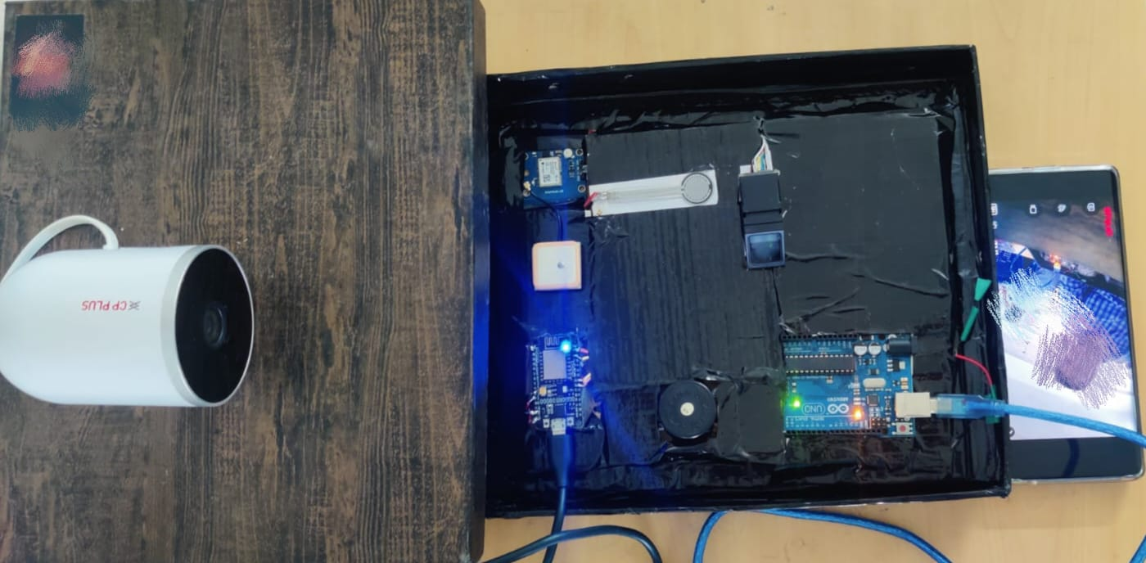
PROJECT SETUP IoT BASED COLLEGE ATTENDANCE AND TRANPORTATION MONITORING SYSTEM
FigNo:9 Hardware Setup

Slide 23
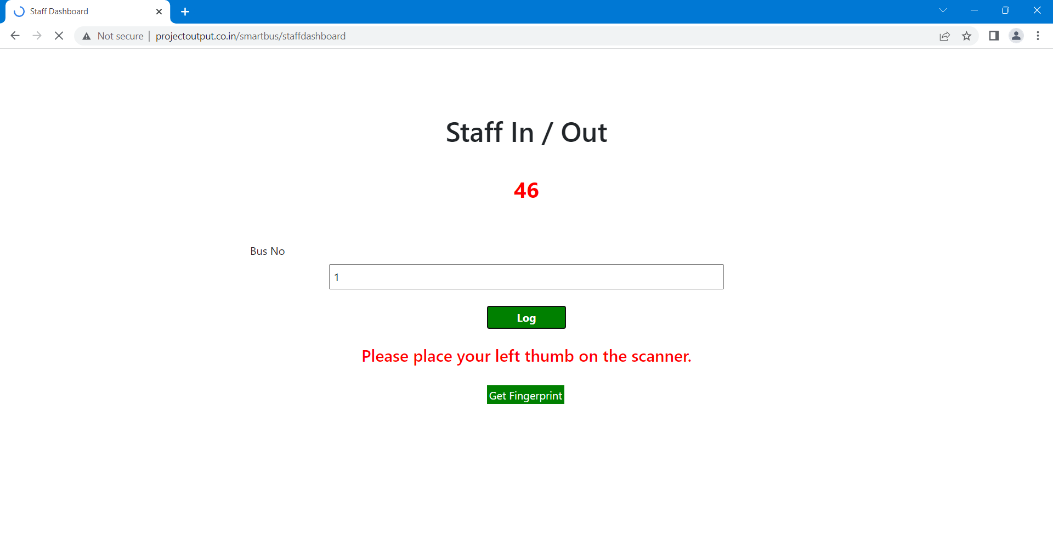
RESULT
FigNo:10 Output For Staffs and Students In Bus Enroll

Slide 24
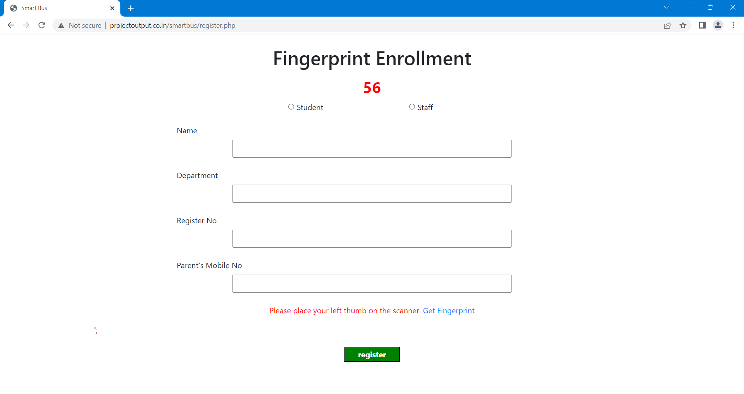
RESULT
Fig.No:11 Output For Staffs and Students Fingerprint Enrollment

Slide 25
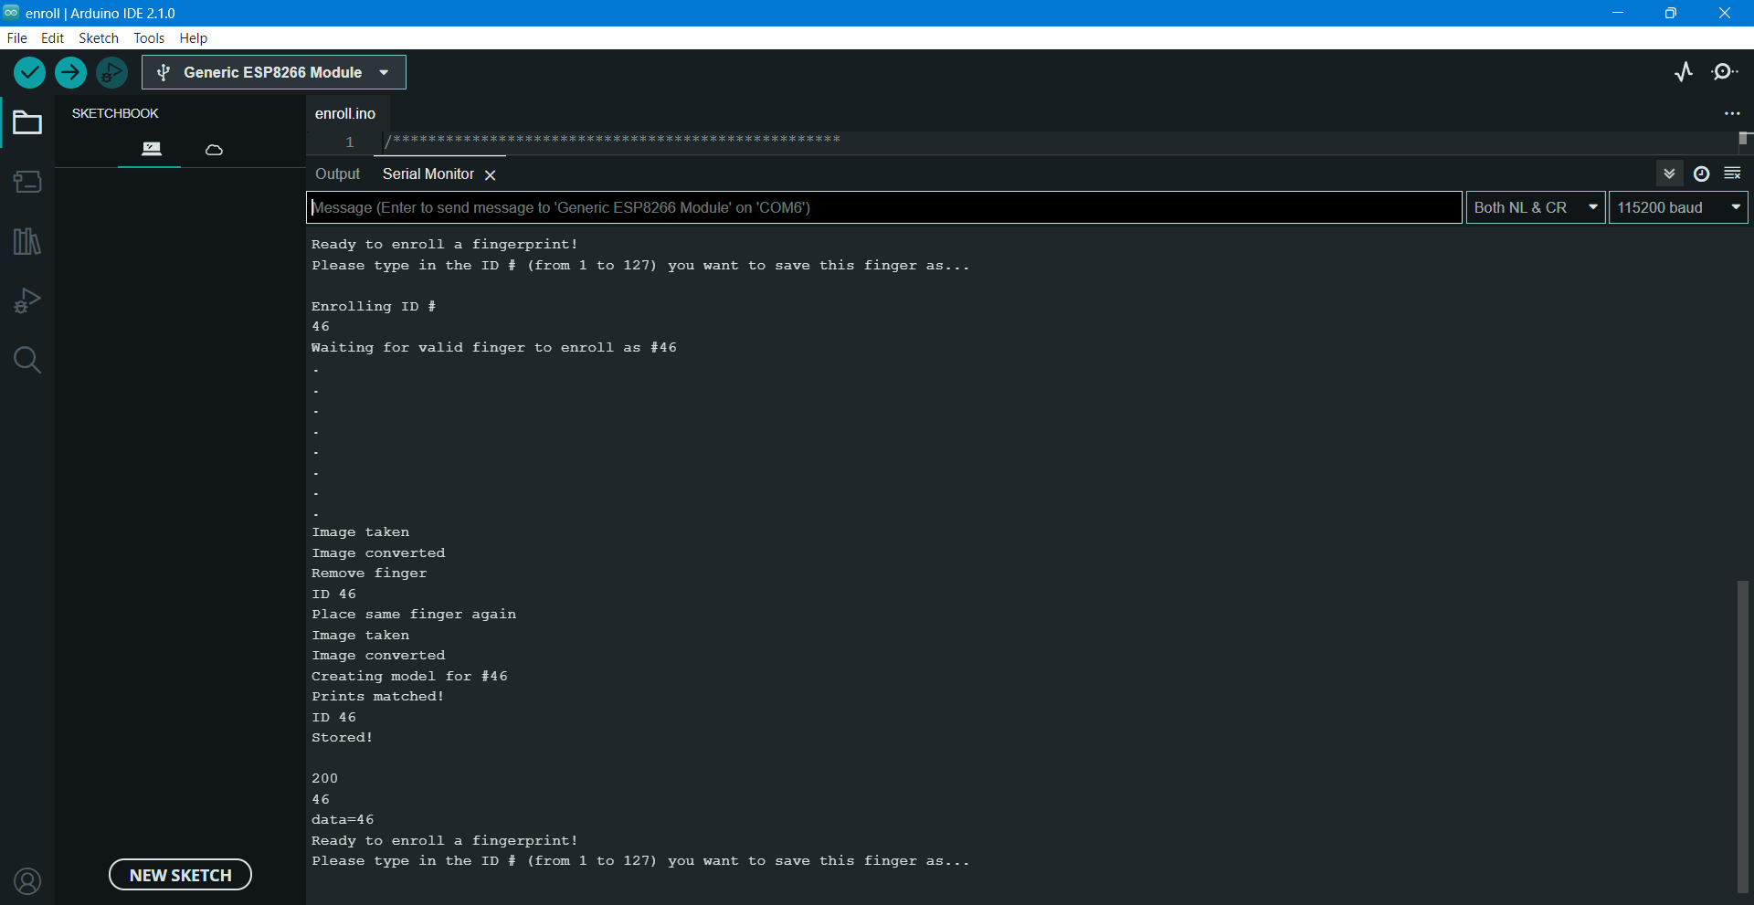
RESULT
Fig.No:12 Serial Monitor Based Fingerprint Enrollment

Slide 26
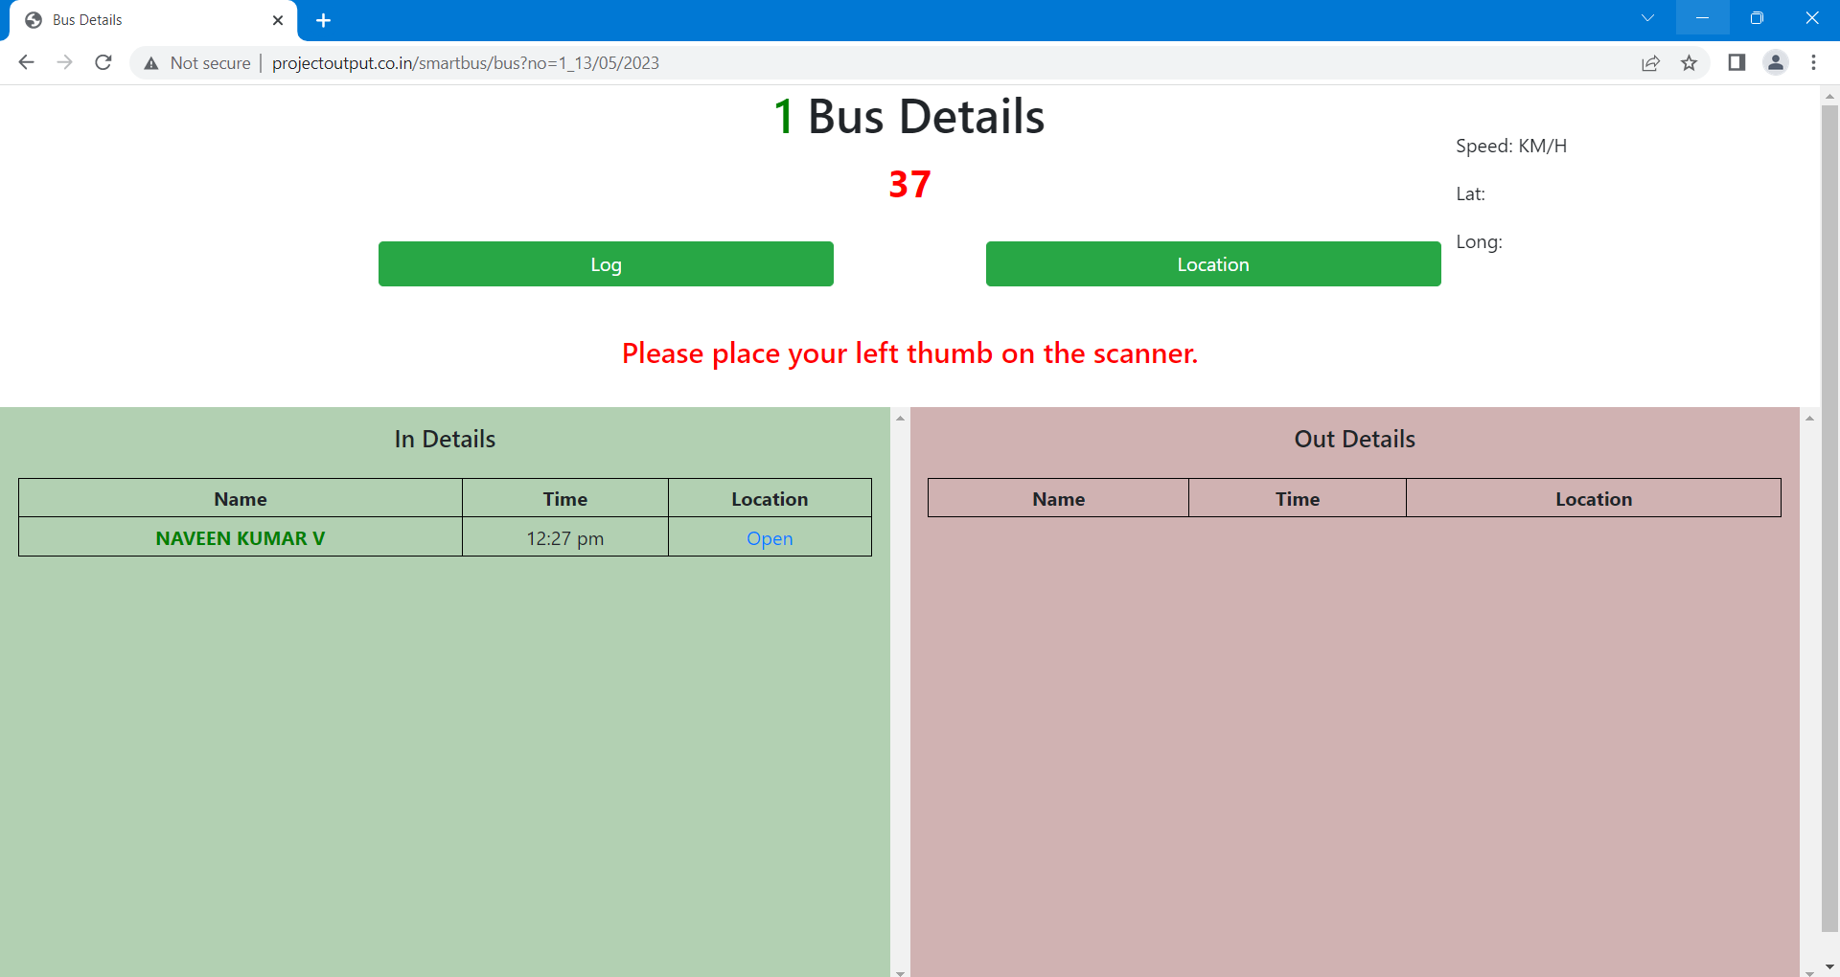
RESULT
Fig.No:13 Staffs And Student In Out Details with Time and Location

Slide 27
CONCLUSION
This system is designed to monitor college attendance and transportation using fingerprint recognition.
It uses an IoT-based system to track the attendance of students and faculty in the college.
The system uses a fingerprint scanner to identify the user and records the time of entry and exit. This data is then stored in a database which can be accessed by the college administration.
The system also tracks the transportation of students and faculty by using GPS-enabled devices. This data is also stored in the database and can be used to track the movement of people in the college.
The system also provides real-time alerts to the Parents and college administration in case of any suspicious activity.
This system can be used to improve the security of the college and ensure that students and faculty are safe.

Slide 28
FUTURE SCOPE
If student want to step down from the bus they should place the finger print again in attendance machine for bus door open.
We place the camera Infront of door to detect the person who is placing finger print for exit from bus.
We will develop the Android application for user friendly.

Slide 29
REFERENCES
S. Sangeetha, S.Krishnapriya, Ms. S Janani, “School Bus Tracking And Security System” International Journal of Advance Research in Science and Engineering (IJARSE), Volume No.07, Special Issue No(02), pp218-227,March2018Available:http://www.ijarse.com/images/fullpdf/1521550705_DACE2041ijarse.pdf.
N. Katiran, H. Wahab and J. Rahman, "Development of Attendance System using Biometric Fingerprint Identification", 3rd Engineering Conference on Advancement in Mechanical and Manufacturing for Sustainable Environment, 2010]. Available: Microsoft_Word-12 Norshidah Katiran_19Feb2010
N. Zainal, K. Sidek, T. Gunawan, H Mansor and M. Kartiwi, "Design and development of portable classroom attendance system based on Arduino and fingerprint biometric", The 5th International Conference on Information and Communication Technology for The Muslim World (ICT4M), 2014. Available:https://ieeexplore.ieee.org/abstract/document/7020601/references#references
A. Bijlani, S. Suresh and P Praful, "Attendance Monitoring in Classroom Using Smartphone and Wi-Fi Fingerprinting", IEEE Eighth International Conference on Technology for Education (T4E), 2016. Available: https://ieeexplore.ieee.org/abstract/document/7814796
Rajasekhar and S. Vivek, "Wireless Fingerprint Attendance System using Zigbee Technology", International Journal of Power Control Signal and Computation(IJPCSC), 2012. Available:attendance-libre.pdf (d1wqtxts1xzle7.cloudfront.net)

Slide 30
APPENDIX- I
Coding For IoT Based College Attendance and Transportation Monitoring System
#include <LiquidCrystal.h>
#define CMDBUFFER_SIZE 32
const int rs = 12, en = 11, d4 = 5, d5 = 4, d6 = 3, d7 = 2;
LiquidCrystallcd(rs, en, d4, d5, d6, d7);
const int buzzer = 9;
void setup() {
Serial.begin(115200);
pinMode(buzzer, OUTPUT);
lcd.begin(16, 2);
lcd.print(" Finger Print");
lcd.setCursor(0,1);
lcd.print(" Attendance");
while (!Serial);
void loop() { // run over and over
serialEvent();
}
void serialEvent()
{
static char cmdBuffer[CMDBUFFER_SIZE] = "";
char c;
while(Serial.available())
{
c = processCharInput(cmdBuffer, Serial.read());
Serial.print(c);
if (c == '\n')
Serial.println();
if (strcmp("No finger detected", cmdBuffer) == 0){
lcd.begin(16, 2);
lcd.print(" Waiting For");
lcd.setCursor(0,1);
lcd.print(" Finger...");

Slide 31
lcd.begin(16, 2);
lcd.print("Fingerprint sensor");
lcd.setCursor(0,1);
lcd.print(" enrollment");
}else if (strcmp("Found fingerprint sensor", cmdBuffer) == 0)
lcd.begin(16, 2);
lcd.print("Found Fingerprint");
lcd.setCursor(0,1);
lcd.print(" sensor");
}else if (strcmp("Did not find fingerprint sensor", cmdBuffer) == 0)
lcd.begin(16, 2);
lcd.print("Did not find");
lcd.setCursor(0,1);
lcd.print("fingerprint sensor");
}else if (strcmp("Please type in the ID # (from 1 to 127) you want to save this finger as...", cmdBuffer) == 0)
char processCharInput(char* cmdBuffer, const char c)
{
if (c >= 32 && c <= 126) //Ignore control characters and special ascii characters
{
if (strlen(cmdBuffer) < CMDBUFFER_SIZE)
{
strncat(cmdBuffer, &c, 1); //Add it to the buffer
else
{
return '\n';
}
}
else if ((c == 8 || c == 127) &&cmdBuffer[0] != 0) {
cmdBuffer[strlen(cmdBuffer)-1] = 0;
}
return c;

Slide 32
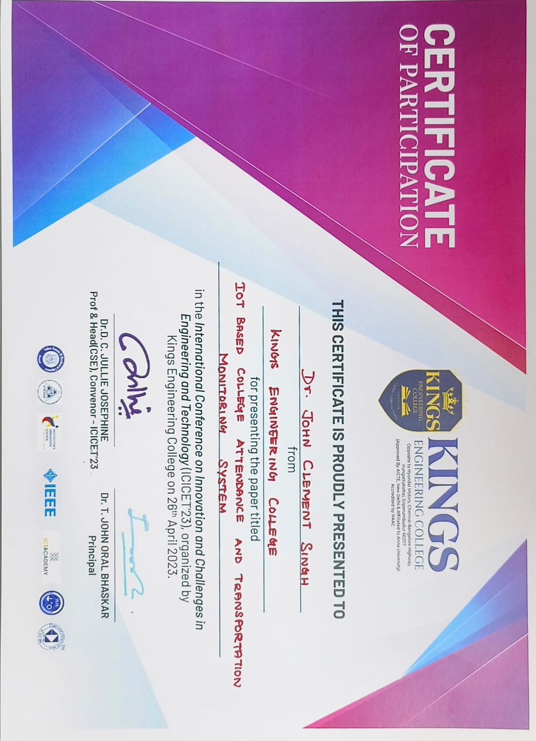
APPENDIX- II
CERTIFICATES

Slide 33
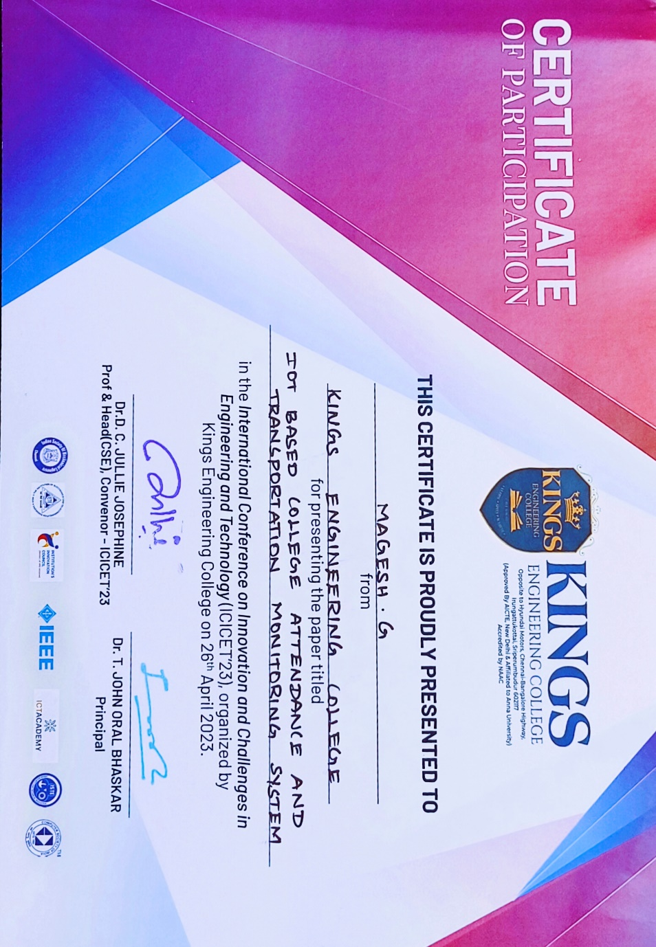

Slide 34
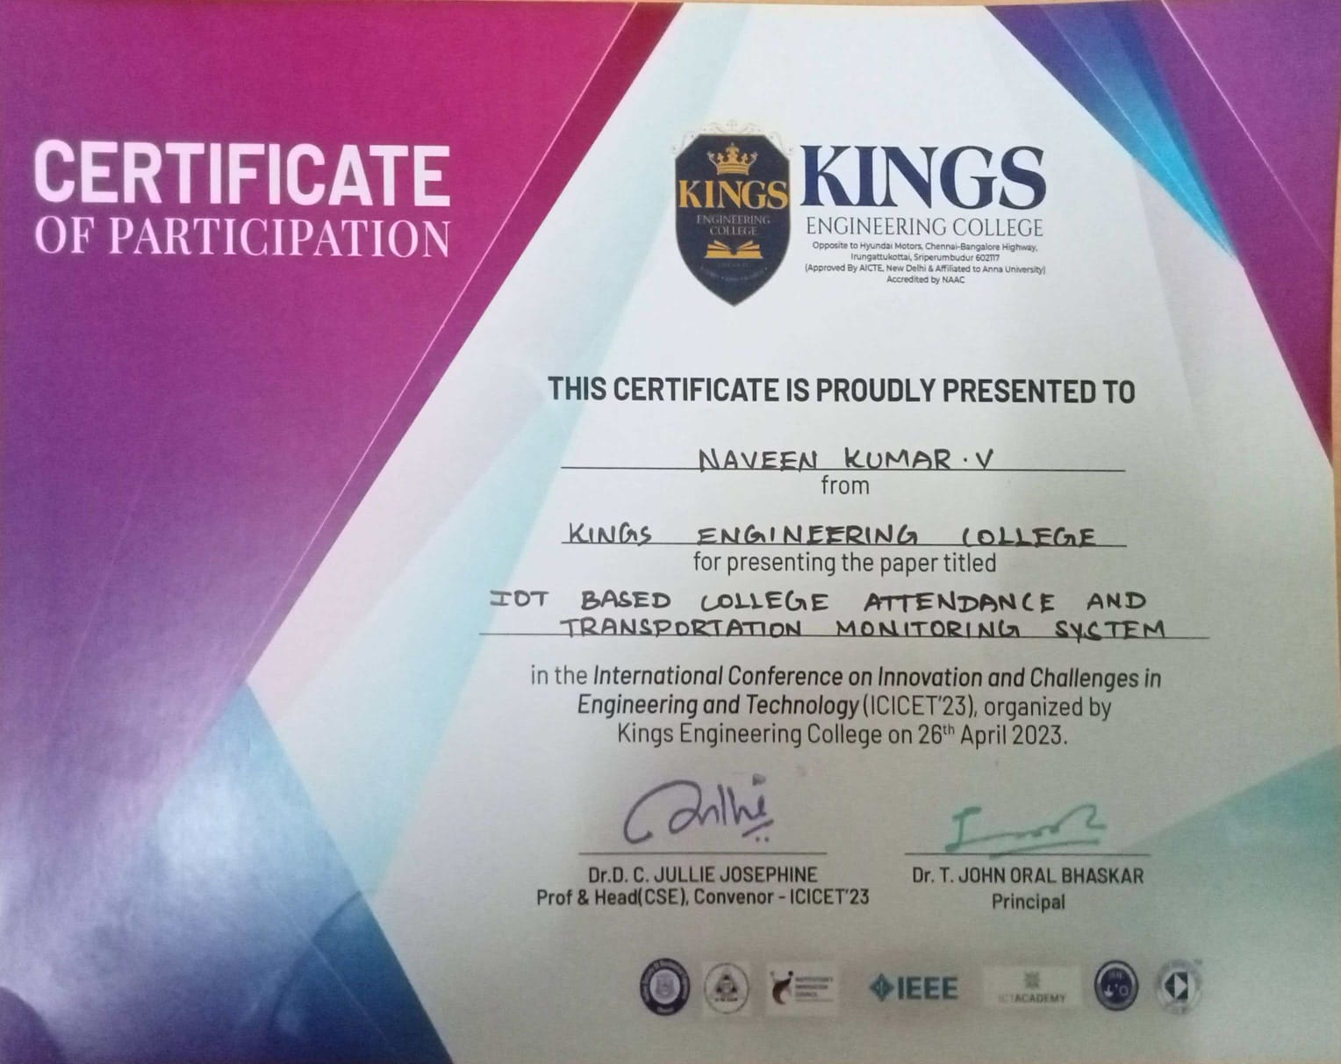

Slide 35


